Slide 1
Exploring Electric Vehicles Through Data
A Demo Report on Trends, Technology, and Brand Performance
Date : 29 July 2025
Name : Priyanshu

Slide 2
Exploring the Electric Vehicle Landscape with Power BI
🔍 What this presentation covers:
Efficiency trends across EV brands
Battery types, charging power, and segment analysis
Range distribution and acceleration comparisons
Real-world insights using interactive dashboards
📊 Tools Used: Microsoft Power BI, Excel 📁 Dataset: Electric Vehicle Specifications (Global Market)

Slide 3
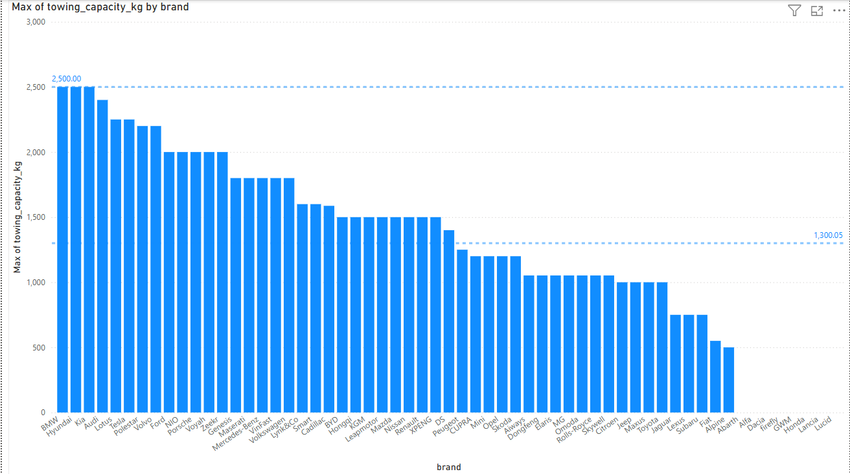
Brands VS Maximum of towing capacity in kg
🚗 Towing Capacity Analysis of Car Brands
🔹 Maximum Towing Capacity : 2500 kg ➤ Brands: BMW, Hyundai, Kia
🔹 Zero Towing Capacity : 0 kg ➤ Brands: Abarth, Alfa Romeo, Dacia,
Firefly, GWM, Honda, Lancia, Lucid
📊 Summary Statistics
Highest Capacity: 2500 kg
Lowest Capacity: 0 kg
Average Capacity: 1300.05 kg

Slide 4
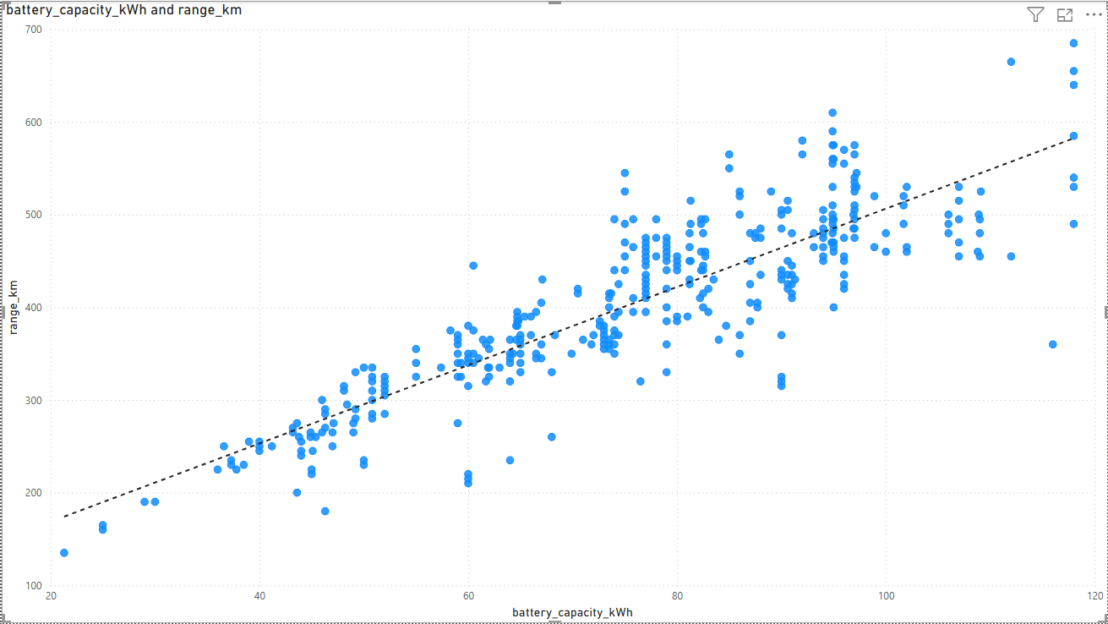
Battery Capacity in KWh VS Range in km
📈 Insight:
As battery capacity increases, the driving range (in kilometers) also increases proportionally, indicating a direct correlation between energy storage and travel distance in EVs.
A
Observation in section A :
The majority of values are densely clustered within the range of:
Battery Capacity: 75 kWh to 98 kWh
Driving Range: 400 km to 550 km
📊 This indicates a common industry standard or optimal balance between battery size and range in current EV models.

Slide 5
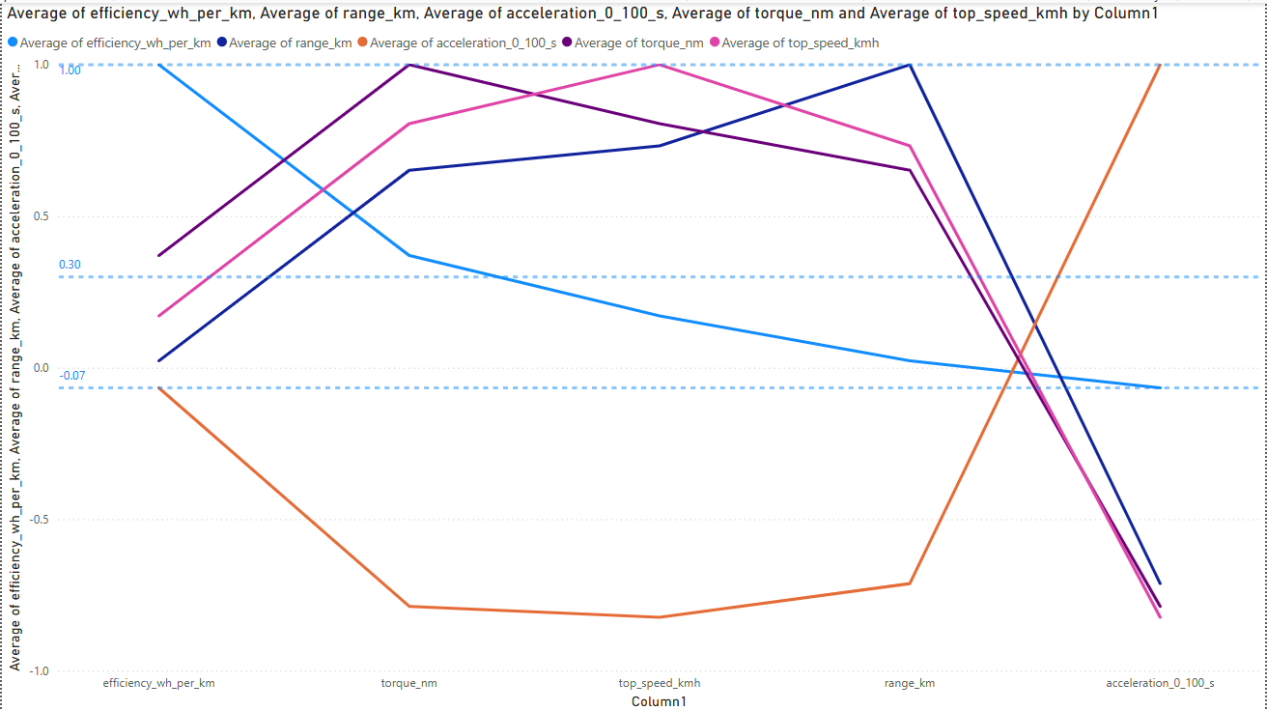
Correlation btw efficiency , Torque , top speed , range , acceleration
🔻 Negative Correlations :
Acceleration also shows a negative correlation with: ➤ Efficiency, Torque, Top Speed, Range
Torque , top speed ,range also shows a negative correlation with:
Acceleration

Slide 6
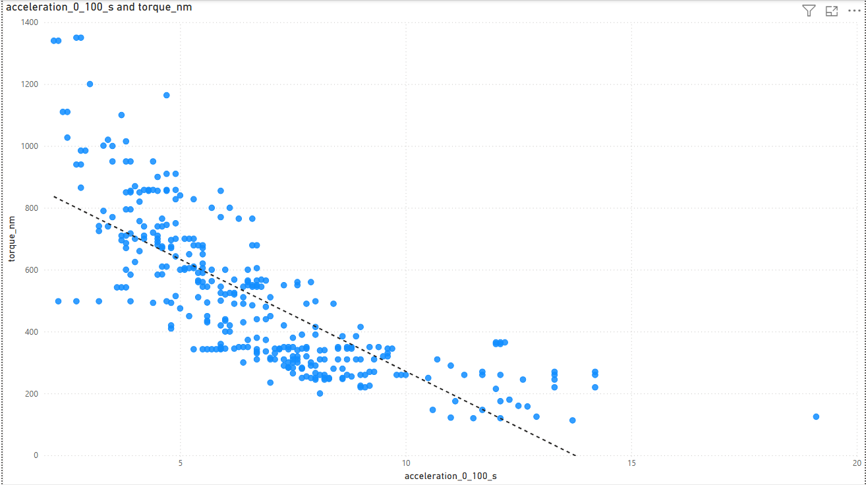
Acceleration VS torque
According to the data, as the acceleration time (0–100 km/h in seconds) increases, the torque tends to decrease.
This section shows the highest density, where most vehicles accelerate from 0 to 100 km/h in 5 to 10 seconds with a torque range of 200 Nm to 400 Nm.

Slide 7
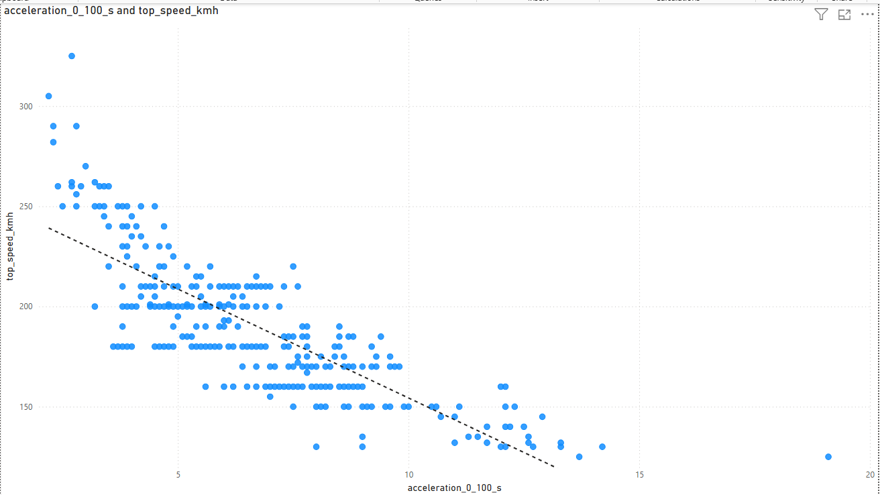
Acceleration VS top speed
Section A shows the most frequent values, where acceleration from 0 to 100 km/h typically occurs between 3.6 and 9 seconds, with corresponding top speeds ranging from 160 to 210 km/h.
A

Slide 8
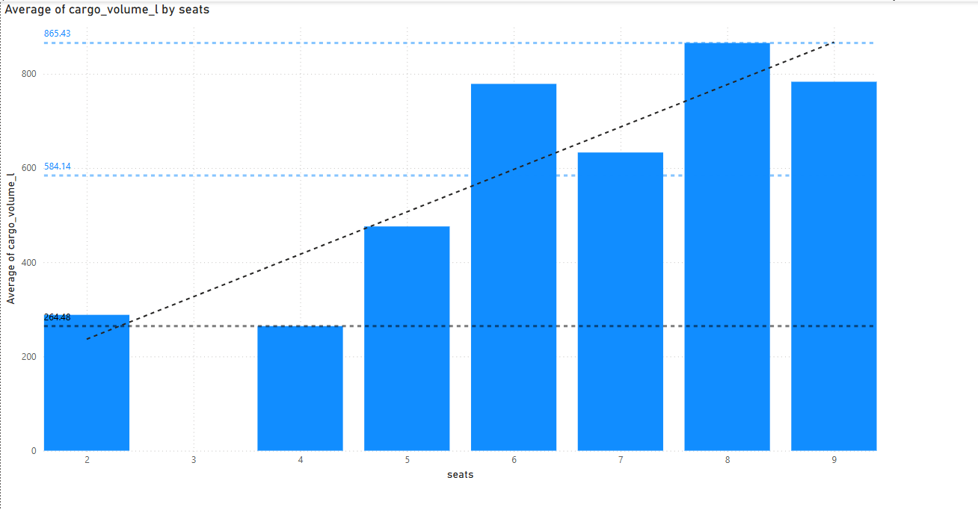
Seats VS Average cargo volume in liter
Cargo Volume Insights by Seating Capacity :
Lowest cargo volume: Found in a 4-seater car — 264.48 Liters
Highest cargo volume: Found in an 8-seater car — 865.43 Liters
Note: No cars in the dataset have 3 seats

Slide 9
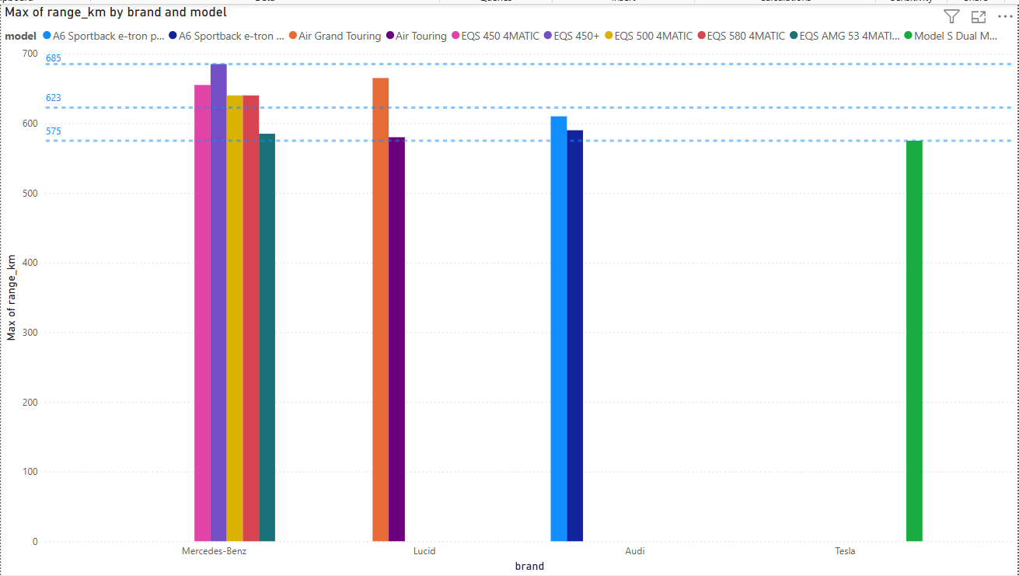
Brand VS maximum Range in Km
Electric Car Range Insights (in Kilometers):
🔼 Maximum Range: Mercedes-Benz EQS 450+ has the highest range
🔽 Minimum Range: Tesla Model S Dual Motor has the lowest range
📊 Brand with Most Cars Above Average Range: Mercedes-Benz has the highest number of models exceeding the average range

Slide 10
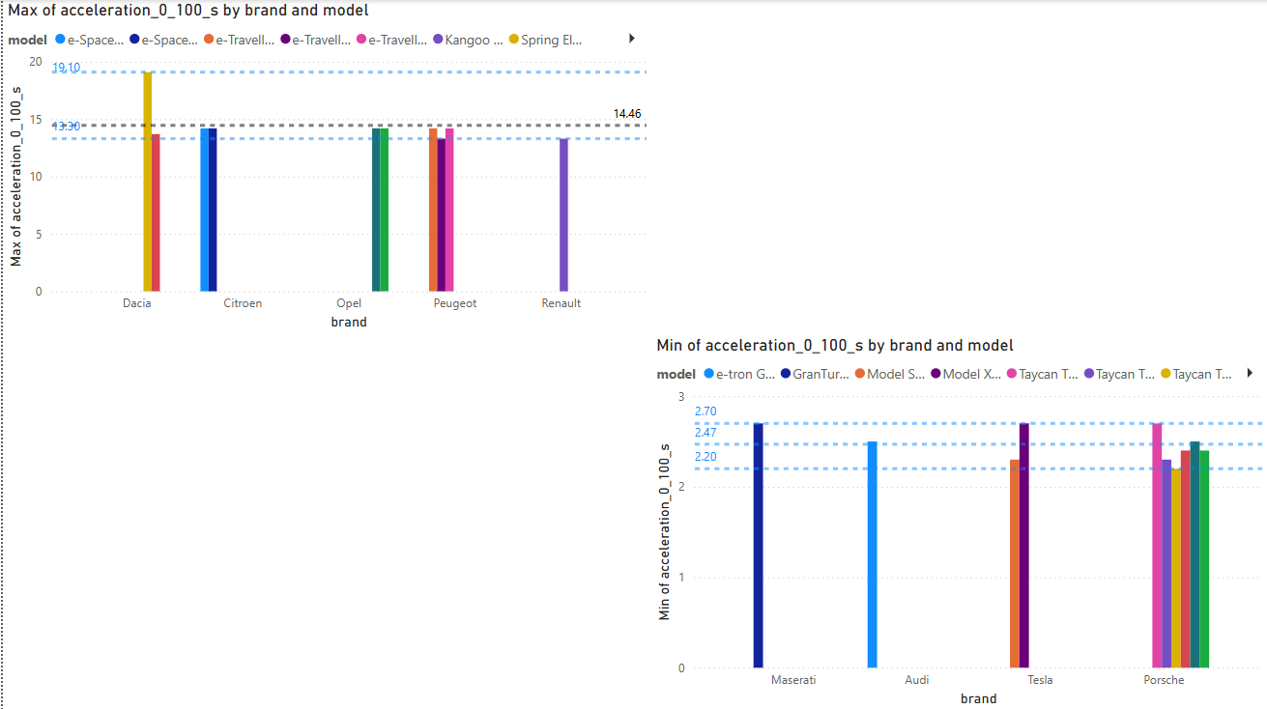
Brand VS Max. and min. of acceleration from 0 to 100 in sec
Top Electric Cars with the Fastest Acceleration (0–100 km/h)
⚡ Fastest Acceleration (Minimum Time): Porsche Taycan Turbo GT Weissach – 2.20 sec
🔥 Close Competitors (2.70 sec):
Tesla Model X Plaid
Maserati GranTurismo Folgore
Porsche Taycan Turbo
🏁 Lower acceleration time = quicker launch. These are the beasts of electric speed!
Cars with the Slowest Acceleration (0–100 km/h in Seconds)
🐢 Slowest Acceleration (Maximum Time): Dacia Spring Electric 45 – 19.10 sec
🚶‍♂️ Second Slowest: Renault Kangoo Grand E-Tech Electric – 13.30 sec
🧠 Note: Higher acceleration time = slower speed pickup

Slide 11
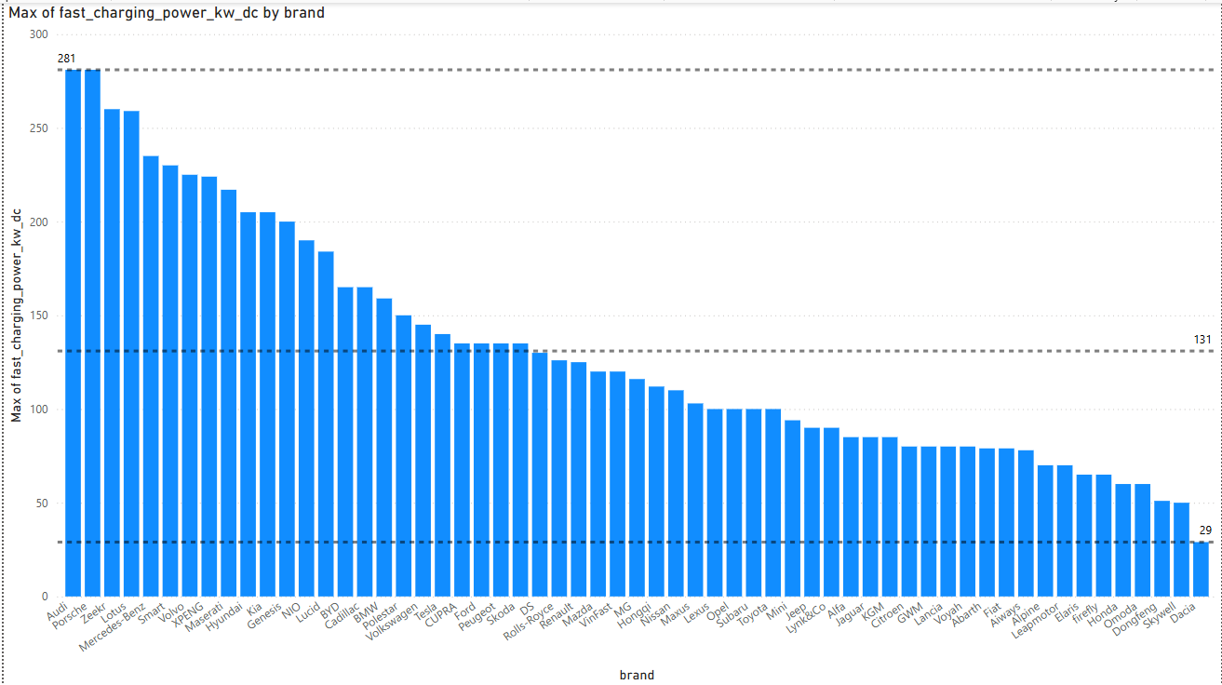
Brand VS Maximum of fast charging power Kw_Dc
Fast Charging Power Analysis (kW DC)
🔼 Maximum Fast Charging Power: Audi and Porsche — 281 kW
🔽 Minimum Fast Charging Power: Dacia — 29 kW
📊 Brand Distribution vs. Average:
24 brands have fast charging power above the average
35 brands fall below the average
💡 Majority of car brands offer lower-than-average fast charging speeds, indicating room for improvement in charging infrastructure or battery compatibility.

Slide 12
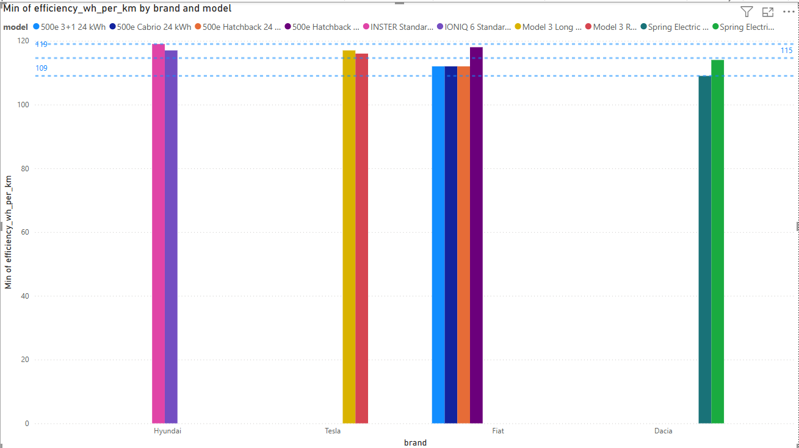
Brand VS Efficiency Wh per Km
Top Efficient Electric Cars (Based on Energy Consumption)
✅ Most Efficient Car: Dacia Spring Electric 45
❌ Least Efficient Car: Hyundai INSTER Standard Range
💡 Efficiency is measured by how little energy (Wh/km) the car uses — lower values indicate higher efficiency.

Slide 13
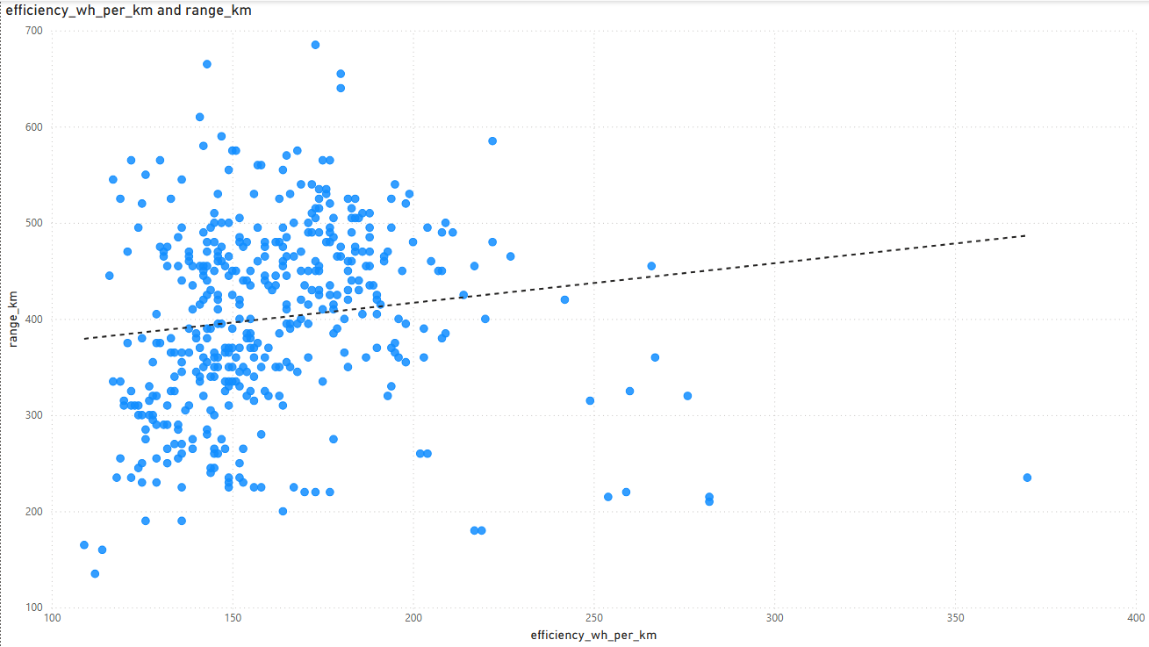
Efficiency VS Range
A
High-Density Efficiency Cluster (Zone A)
Zone A represents the area with the highest frequency of data points, where:
Efficiency ranges from 140 Wh/km to 190 Wh/km
Driving Range falls between 300 km and 530 km
💡 This range indicates the most common balance between energy consumption and range in current electric vehicle models.

Slide 14
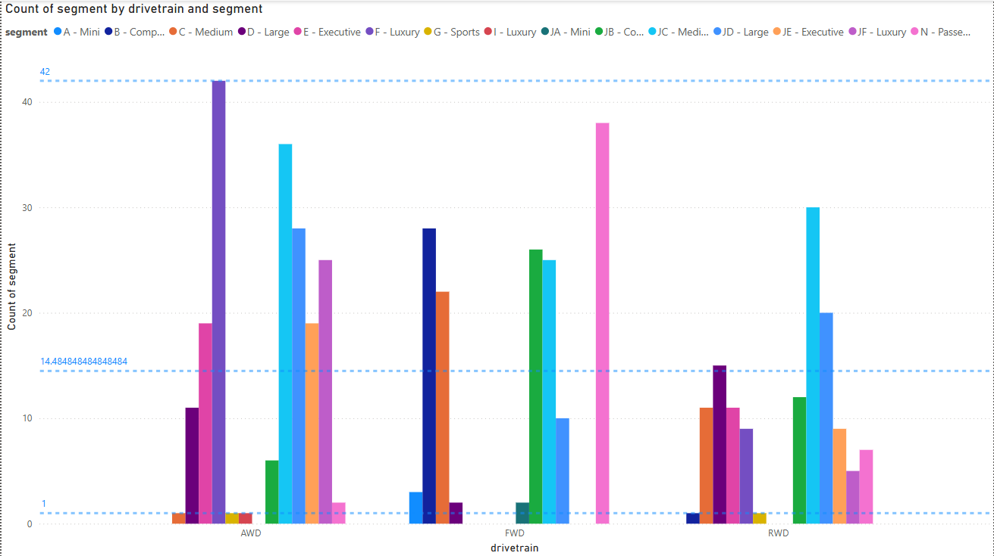
Drivetrain with segment VS count of segment
Segment Distribution by Drivetrain (AWD/RWD)
🔼 Highest Count in AWD: Segment F – Luxury with 42 vehicles
🔽 Lowest Count in AWD/RWD: Segments with only 1 vehicle each: ➤ C – Medium, G – Sports, L – Luxury, B – Compact
📊 Segment Count vs Average:
19 segments have a count below the average
14 segments are above the average
💡 Luxury vehicles dominate AWD offerings, while some segments like sports and compact appear less frequently in AWD/RWD setups.

Slide 15
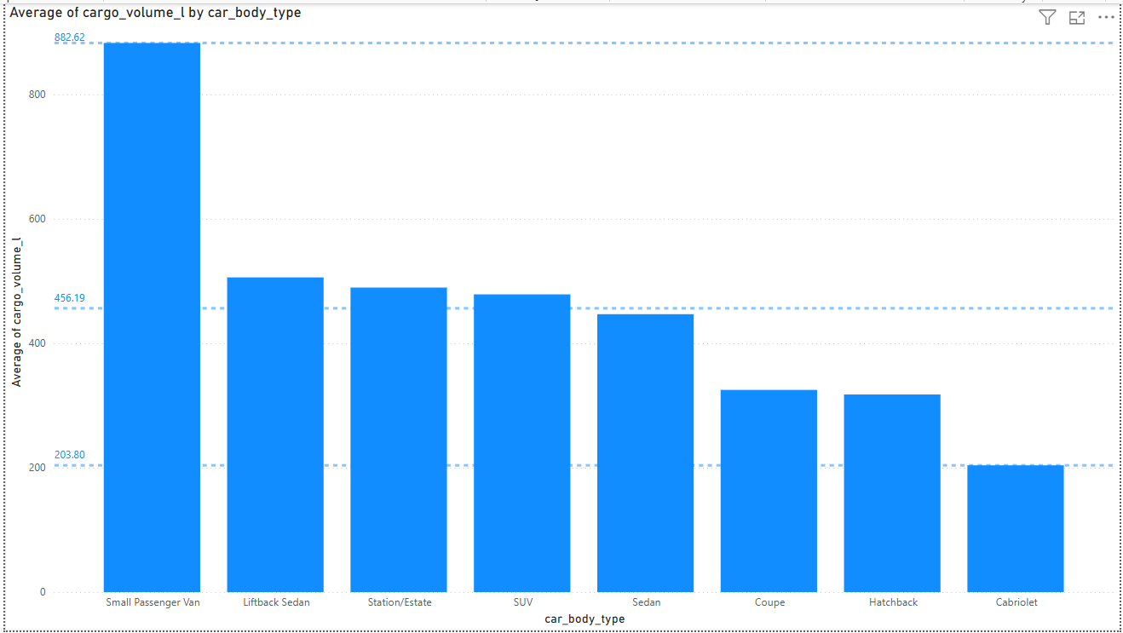
Car body type VS cargo volume in litre
Cargo Volume by Car Body Type
🔼 Maximum Cargo Volume: Small Passenger Van — 882.62 Liters
🔽 Minimum Cargo Volume: Cabriolet — 203.80 Liters
💡 Vans offer the highest practicality in storage space, while cabriolets trade cargo capacity for design and performance.

Slide 16
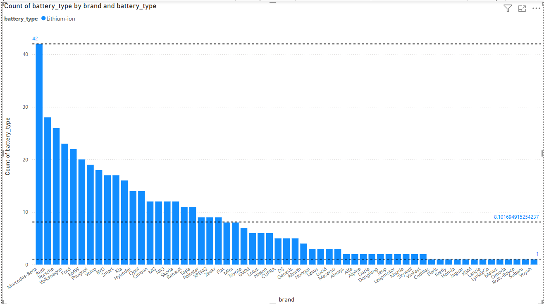
Brand VS count of battery type
Battery Type Distribution by Brand
🏆 Most Diverse Battery Types:
Mercedes-Benz – 42 different battery types (Leading in battery versatility and innovation)
🥈 Second Highest Variety: Audi – 28 battery types (Indicating strong portfolio depth)
🔽 Minimum Variety (Only 1 Battery Type): Brands like Cadillac, Elaris, Firefly, Honda, Jaguar, KGM, Lancia, Lynk & Co, Maxus, Omoda, Rolls-Royce, Subaru, Voyah
💡 Luxury and legacy brands like Mercedes-Benz and Audi are leading in battery diversity, whereas niche or newer market entrants stick to a single solution.
🔍 Observation: There is a significant drop in the number of battery types used by brands:
Mercedes-Benz leads with 42 battery types
The next in line, Audi, uses only 28 types ➡️ A sharp decline of 14 battery types
This large gap suggests Mercedes-Benz is taking a highly diversified battery strategy, possibly aiming to optimize across segments, regions, or performance classes. Audi, while still diverse, has a noticeably more focused approach.

Slide 17
Combined Insights – What the Data Tells Us
✅ 1. Dacia – Best in Efficiency, Not in Speed
Dacia Spring Electric 45 is the most efficient car (lowest Wh/km).
But it also has the slowest acceleration (0–100 km/h in 19.10 sec).
🔁 Insight: Dacia focuses on energy-saving and economy, not performance.
✅ 2. Power vs. Efficiency – Often a Trade-off
Brands that offer high acceleration (like sports or luxury cars) often have lower efficiency (higher Wh/km).
Example: Hyundai INSTER has lower efficiency compared to Dacia but may offer better acceleration or features.
✅ 3. Segment Influence Is Clear
Luxury (F-Segment) dominates AWD configurations (42 cars), indicating more premium cars focus on power/performance.
Compact or medium segments have limited AWD, aligning with their economy and efficiency goals.
✅ 4. Battery Diversity = Brand Strategy
Mercedes-Benz leads with 42 different battery types – a sign of a broad product range.
Most other brands have far fewer, suggesting focused or budgeted offerings.
✅ 5. Range vs Efficiency Cluster
Most cars fall between 140–190 Wh/km with a range of 300–530 km.
This range is where majority of consumer-focused EVs lie — a balance of range and consumption.
✅ 6. Cargo Volume and Purpose
Vans and family cars like small passenger vans have highest cargo space.
Cabriolets (convertibles) have the lowest — showing how design impacts utility.

Slide 18
Thank You for Your Time and Attention!
I hope the insights shared today gave you a deeper understanding of electric vehicle trends across brands, efficiency, performance, and technology.
Special thanks for your interest and curiosity – it drives meaningful discussions and innovation.

